Slide 1


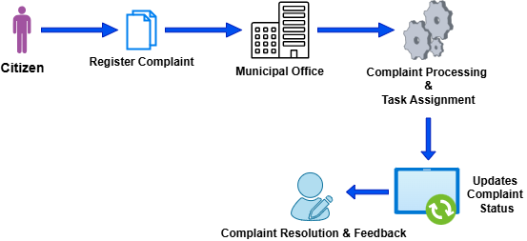
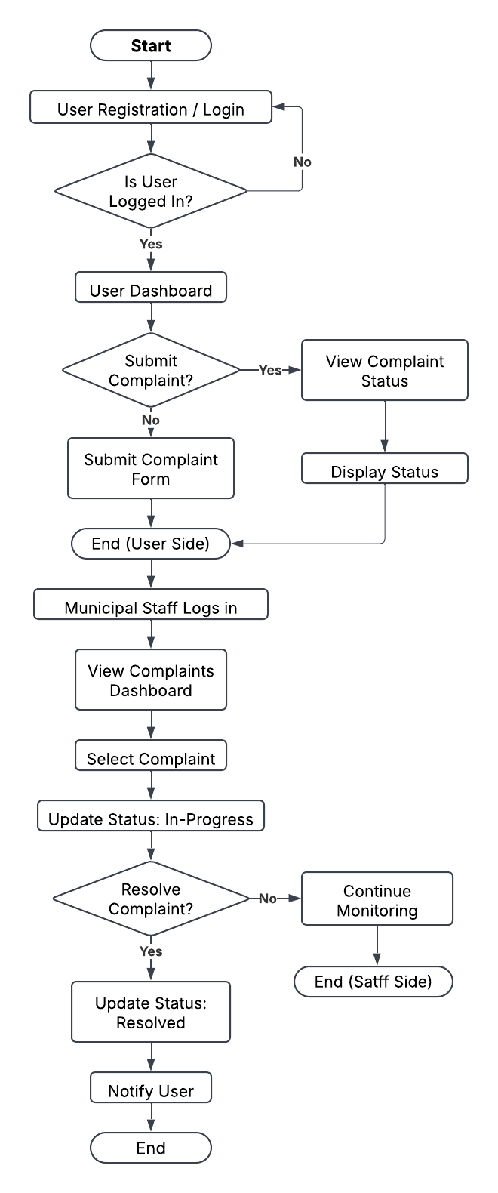
Clean Society
Dhruv V. Patel (2023095900004485)
Ayush R. Patel (2023095900004493)
Shivam N. Patel (2023095900004504)
Krish V. Patel (2022095900023543)
Harsh M. Modi (2023095900026456)
Guided By
Mr. Jinit S. Raval
CE Department, SPCE
INTRODUCTION
OBJECTIVE
METHODOLOGY
DESIGN OF SYSTEM
TOOLS & TECHNOLOGY
CONCLUSION
V-
INTRODUCTION:
In today’s rapidly urbanizing world, effective waste management remains a critical challenge for municipalities, impacting public health, environmental sustainability, and the overall quality of life. The CleanSociety project aims to bridge the gap between citizens and municipal authorities by providing an innovative, technology-driven platform for efficient garbage collection and complaint resolution. This project enables users to register complaints about uncollected waste directly with their local municipality office. The municipality, in turn, receives, processes, and resolves these complaints as quickly as possible. By integrating technology into waste management, CleanSociety aims to improve municipal efficiency, enhance public health, and promote civic engagement. The platform will include user-friendly interfaces for complaint registration, real-time tracking, and notifications to keep users informed about the resolution progress. This project aligns with the Smart City vision and contributes to a cleaner, healthier society.
FUNCTIONALITY:
1. User Functionality:
User Registration & Login with secure authentication.
Submit Complaint with location, description, and optional images.
Track Complaint Status (Received, In Progress, Cleared).
Provide Feedback & Ratings after complaint resolution.
2. Municipal Office Features:
Complaint Management Dashboard to view and manage complaints.
Task Assignment to field workers for garbage collection.
Update Complaint Status and add resolution notes.
Monitor Performance of complaint resolution and staff efficiency.
3. Admin Features:
Manage Users & Complaints (citizens and municipal staff).
Configure System Settings (categories, notifications, and roles).
Generate Reports & Analytics for performance tracking.
Figure 1: working of system
OBJECTIVE
Enhance urban and rural cleanliness by develop an efficient and user-friendly platform for citizens to report garbage collection complaints.
Enable municipal offices to receive, manage, assign, and track complaints effectively.
Allow users to register complaints with details such as location, description, and images.
Provide real-time status updates and notifications to enhance transparency and accountability.
Foster trust between citizens and local authorities through an organized complaint resolution system.
Promote cleanliness, improve public health, and strengthen citizen-authority communication.
DESIGN OF SYSTEM
METHODOLOGY
PROBEM GAP
The CleanSociety web project, aimed at allowing users to register garbage collection complaints for rapid resolution by the municipality, follows a concise methodology.
It starts with initiation, defining scope and stakeholders, followed by requirements analysis to gather needs like complaint forms and admin panels.
Next, system design outlines the architecture and UI, leading to development, where the platform is built with features like geolocation and notifications.
Testing ensures functionality and security, then deployment launches it on a cloud server with a pilot phase.
Finally, maintenance keeps it running smoothly, incorporating feedback and scaling as needed, all within a 4-6 month timeline for initial rollout.
METHODOLOGY
TOOLS & TECHNOLOGY
Frontend: HTML, CSS, JavaScript
Backend: PHP, Python (3.8.5)
Database: MySQL (V8.0.27)
Authentication: OAuth 2.0
APIs & Integrations: Google Maps API – Location tracking
Development Tools: Visual Studio Code(1.97.2), XAMPP Control Panel(v3.3.0)
CONCLUSION
Clean Society ensures efficient garbage complaint management, enhances transparency, improves waste disposal, and promotes community engagement. Its scalable and technology-driven approach makes it adaptable for multiple municipalities, contributing to a healthier and more sustainable environment.
REFERENCES
Ministry of Housing and Urban Affairs, Swachh Bharat Mission (Urban) Guidelineshttps://swachhbharatmission.gov.in
Municipal Solid Waste Management Rules, 2016 Ministry of Environment, Forest and Climate Change, Government of India
Local Municipal Corporation guidelines for waste management

